Slide 1
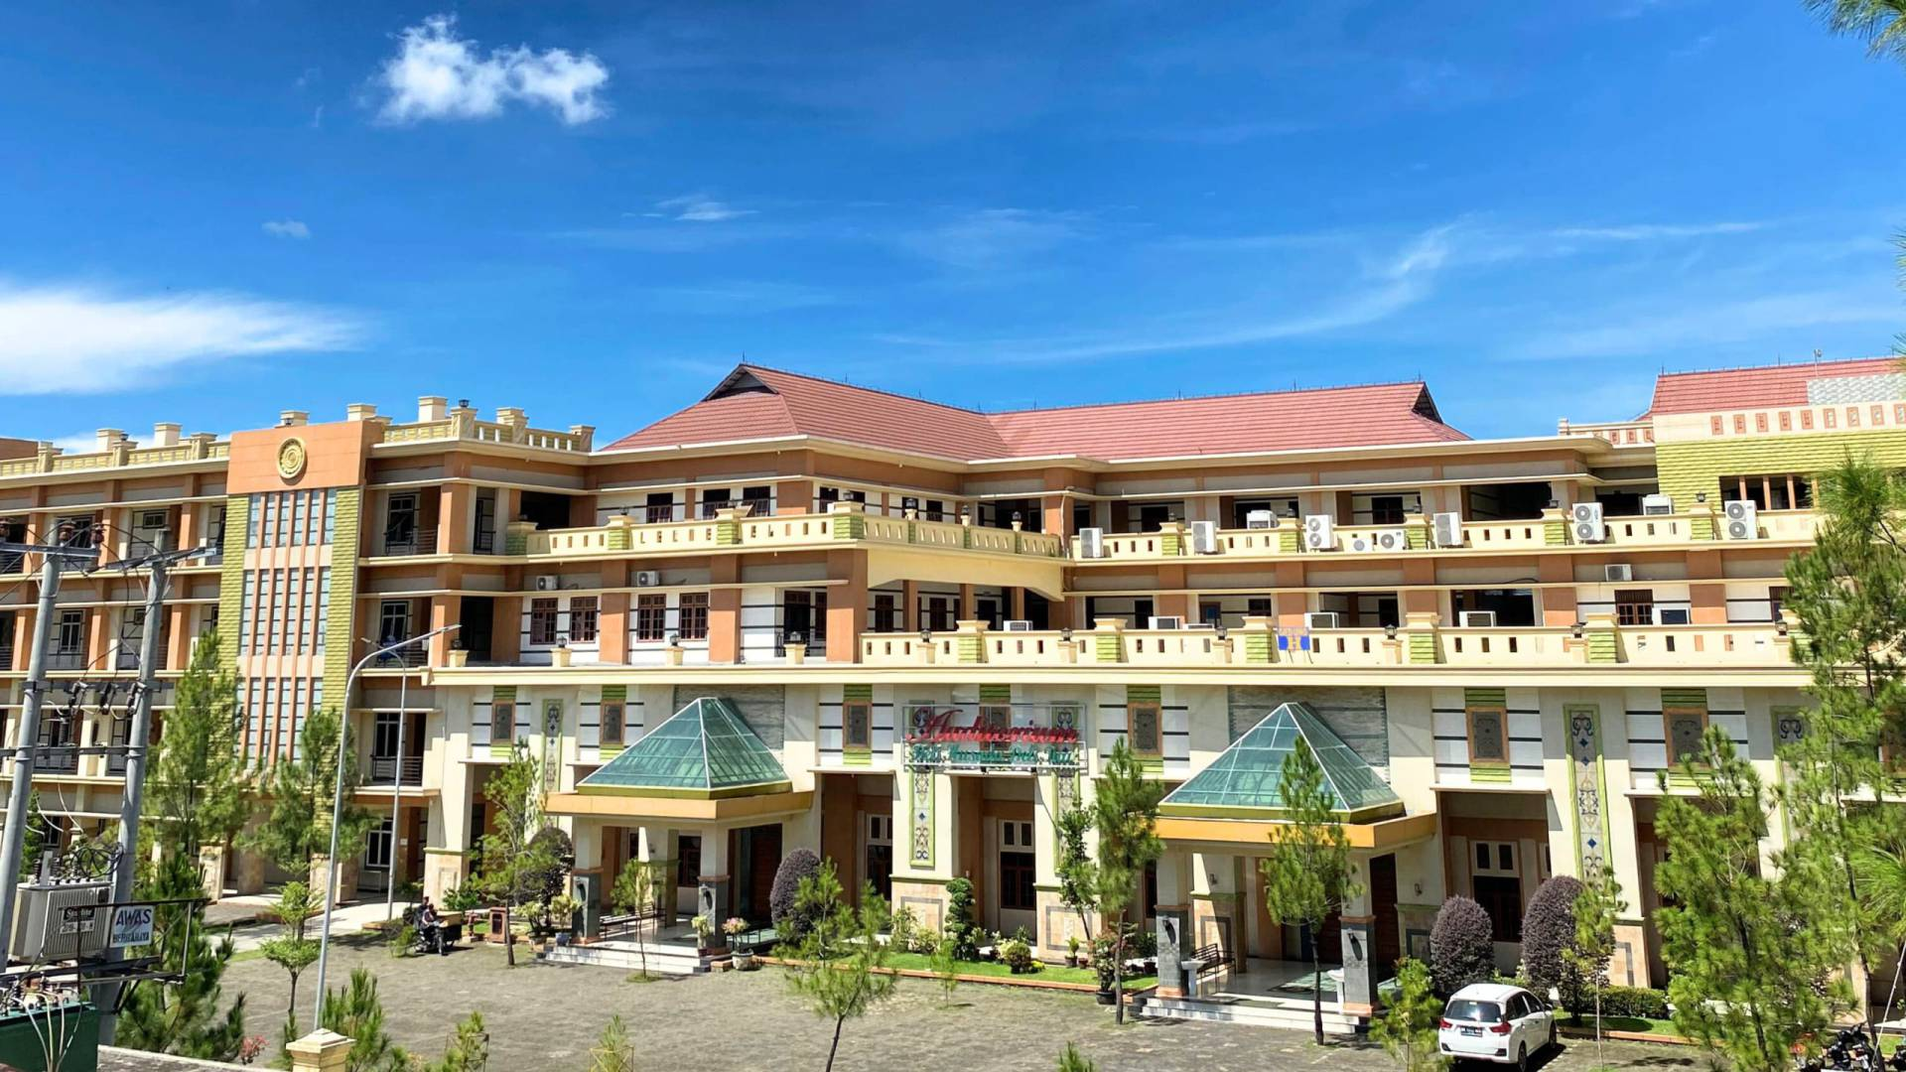
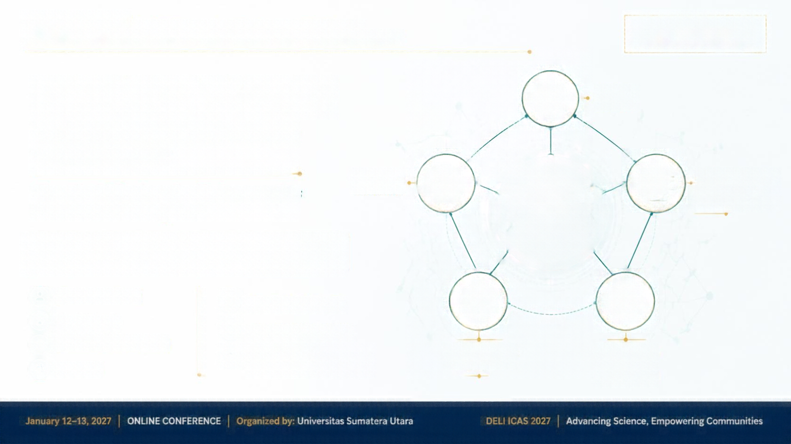
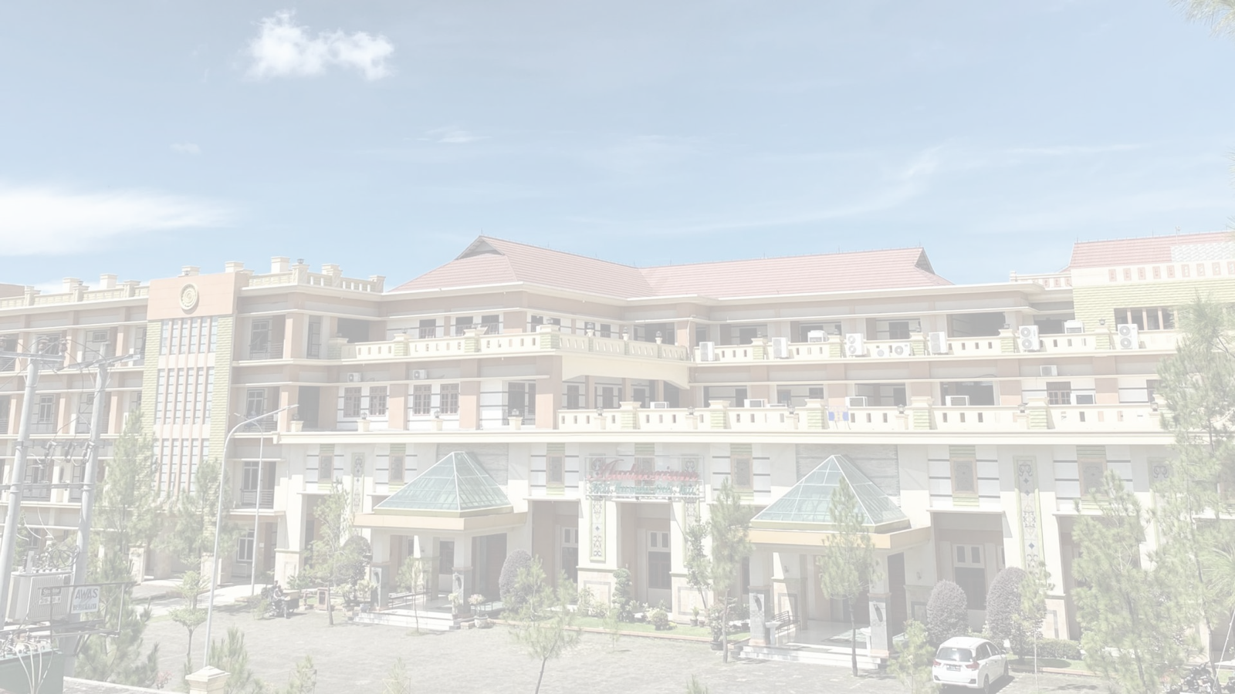

















DELI ICAS 2027
The 2nd Deli International Conference on Allied Sciences
Institut Kesehatan Deli Husada Delitua
DELI HUSADA
Health Professional Trainning
And Learning Centre
Official Theme: “One Health for Sustainable Communities in the Era of Society 5.0”
DELI ICAS 2027
HEALTH
SCIENCES
The 2nd Deli International Conference on Allied Sciences
SCIENCE AND INNOVATION
DIGITAL TECHNOLOGY AND ARTIFICIAL ANTELLIGENCE
“One Health for Sustainable Communities in the Era of Society 5.0”
MULTIDISCIPLINARY SCIENCES FOR SUSTAINABLE COMMUNITIES
[INSERT RESEARCH TITLE]
[Presenter Name]
January 12–13, 2027
[Co-Authors]
ONLINE CONFERENCE
[Institutional Affiliation]
ENVIRONMENT AND SUSTAINABILITY
EDUCATION AND COMMUNITY EMPOWERMENT
[Country]
January 12–13, 2027
ONLINE CONFERENCE
Organized by: Doctoral Program in Public Health, Institut Kesehatan Deli Husada Delitua
DELI ICAS 2027
Advancing Science, Empowering Communities

Slide 2





DELI ICAS 2027
The 2nd Deli International Conference on Allied Sciences
Institut Kesehatan Deli Husada Delitua
DELI HUSADA
Health Professional Trainning
And Learning Centre
Official Theme: “One Health for Sustainable Communities in the Era of Digital Transformation”
BACKGROUND
Research Problem
Research Context
[Insert the specific problem or challenge that motivates this research.]
[Insert a concise description of the research area, importance, and relevance to sustainable communities.]
Current Scientific Evidence
[Insert key findings from previous studies and established knowledge related to the topic.]
RESEARCH GAP
[Insert the gap in current knowledge or practice that this study aims to address.]
January 12–13, 2027
ONLINE CONFERENCE
Organized by: Doctoral Program in Public Health, Institut Kesehatan Deli Husada Delitua
DELI ICAS 2027
Advancing Science, Empowering Communities
2

Slide 3















Institut Kesehatan Deli Husada Delitua
DELI HUSADA
Health Professional Trainning
And Learning Centre
Official Theme: “One Health for Sustainable Communities in the Era of Digital Transformation”
RESEARCH OBJECTIVES
[Insert general research objective]

Slide 4

























DELI ICAS 2027
The 2nd Deli International Conference on Allied Sciences
Institut Kesehatan Deli Husada Delitua
DELI HUSADA
Health Professional Trainning
And Learning Centre
Official Theme: “One Health for Sustainable Communities in the Era of Digital Transformation”
RESEARCH METHODS
STUDY DESIGN
STUDY POPULATION
DATA COLLECTION
DATA ANALYSIS
STUDY SETTING
POPULATION AND SAMPLE
SAMPLING TECHNIQUE
DATA COLLECTION
DATA ANALYSIS
Describe the location, context, and timeframe of the study.
Define the target population and eligibility criteria. Specify the sample size and characteristics.
Explain the sampling approach used to select participants or records.
Identify data sources, tools or instruments, and collection procedures.
State the analysis methods or frameworks used
to interpret the data.
This framework is adaptable to systematic reviews, qualitative studies, mixed methods approaches, and implementation research.
January 12–13, 2027
ONLINE CONFERENCE
Organized by: Doctoral Program in Public Health, Institut Kesehatan Deli Husada Delitua
DELI ICAS 2027
Advancing Science, Empowering Communities
4

Slide 5







DELI ICAS 2027
The 2° Deli International Conference on Allied Sciences
Institut Kesehatan Deli Husada Delitua
DELI HUSADA
Health Professional Trainning
And Learning Centre
Official Theme: “One Health for Sustainable Communities in the Era of Digital Transformation”
RESULTS
OUTCOME COMPARISON ACROSS GROUPS
PARTICIPANT CHARACTERISTICS / OUTCOMES SUMMARY
Characteristic / Outcome
Group A
[Insert Data]
Group B
[Insert Data]
p-value
[Insert Data]
100%
75%
50%
25%
0%
Total Participants (n)
[Insert Data]
Age (years), mean (SD)
or n (%)
[Insert Data]
[Insert Data]
[Insert Data]
OUTCOME MEASURE
Gender (n %)
or n (%)
[Insert Data]
[Insert Data]
[Insert Data]
Primary Outcome
(n % or mean SD)
[Insert Data]
[Insert Data]
[Insert Data]
Outcome 1 Outcome 2 Outcome 3 Outcome 4 Outcome 5
Secondary Outcome
(n % or mean SD)
[Insert Data]
[Insert Data]
[Insert Data]
[Insert Data: e.g., scores, rates, percentages, or means]
DESCRIPTIVE RESULTS
KEY
FINDING
[Insert Data] [Insert Percentage]
[Descriptive Results: provide a concise narrative summary of the main outcomes, patterns, and observations from the data.]
[Insert Key Finding: one-sentence conclusion that highlights the most important result.]
January 12–13, 2027 |
ONLINE CONFERENCE
Organized by: Doctoral Program in Public Health, Institut Kesehatan Deli Husada Delitua
DELI ICAS 2027 |
Advancing Science, Empowering Communities

Slide 6











DELI ICAS 2027
The 2nd Deli International Conference on Allied Sciences
Institut Kesehatan Deli Husada Delitua
DELI HUSADA
Health Professional Trainning
And Learning Centre
Official Theme: “One Health for Sustainable Communities in the Era of Digital Transformation”
KEY FINDINGS
FINDINGS SUMMARY
This study identified key patterns and outcomes related to [Insert Topic/Variable].
The results demonstrate meaningful relationships and practical relevance.
Evidence supports the proposed framework and study objectives.
Overall findings are consistent and significant.
INSERT CHART OR FIGURE (QUANTITATIVE OR QUALITATIVE)
Replace this placeholder with your chart, graph, model, or figure to highlight the main evidence.
STATISTICAL ANALYSIS / QUALITATIVE THEMES
COMPARATIVE RESULTS
Insert key statistical results or qualitative themes.
Report test results, significance levels,
or major patterns observed.
Insert comparisons across groups, conditions,
or previous studies.
Highlight differences
and similarities.
KEY
RESULT
[INSERT KEY FINDING]
Summarize the most important result that answers the research question.
January 12–13, 2027
ONLINE CONFERENCE
Organized by: Doctoral Program in Public Health, Institut Kesehatan Deli Husada Delitua
DELI ICAS 2027 |
Advancing Science, Empowering Communities
6

Slide 7












DELI ICAS 2027
The 2nd Deli International Conference on Allied Sciences
[INSERT OFFICIAL
DELI ICAS 2027 LOGO]
Official Theme: “One Health for Sustainable Communities in the Era of Digital Transformation”
DISCUSSION
01
02
03
INTERPRETATION OF FINDINGS
COMPARISON WITH
PREVIOUS STUDIES
SCIENTIFIC IMPLICATIONS
The results indicate that [Insert interpretation]. This suggests that [Insert explanation of what the findings mean].
Our findings align with [Insert supporting study or author] who reported [Insert related finding].
The findings contribute to the growing body of knowledge on [Insert topic].
However, our results differ from [Insert study] which found [Insert contrasting result].
They support the importance of
[Insert key implication].
These findings provide evidence that
[Insert key takeaway from the results].
These similarities and differences may be due to [Insert possible reasons].
Future studies should consider [Insert recommendation for further investigation].
January 12–13, 2027
ONLINE CONFERENCE
Organized by: Doctoral Program in Public Health, Institut Kesehatan Deli Husada Delitua
DELI ICAS 2027
Advancing Science, Empowering Communities
7

Slide 8









DELI ICAS 2027
Institut Kesehatan Deli Husada Delitua
DELI HUSADA
Health Professional Trainning
And Learning Centre
The 2ⁿ⁽ Deli International Conference on Allied Sciences
Official Theme: “One Health for Sustainable Communities in the Era of Digital Transformation”
CONCLUSION
01
02
03
MAIN CONCLUSION
KEY SCIENTIFIC CONTRIBUTION
PRACTICAL IMPLICATION
[Insert main conclusion]
[Insert key contribution]
[Insert key implication]
January 12–13, 2027
ONLINE CONFERENCE
Organized by: Doctoral Program in Public Health, Institut Kesehatan Deli Husada Delitua
DELI ICAS 2027 |
Advancing Science, Empowering Communities
8

Slide 9













DELI ICAS 2027
The 2nd Deli International Conference on Allied Sciences
Institut Kesehatan Deli Husada Delitua
DELI HUSADA
Health Professional Trainning
And Learning Centre
Official Theme: “One Health for Sustainable Communities in the Era of Digital Transformation”
RECOMMENDATIONS & IMPLICATIONS
PRACTICE
POLICY
FUTURE RESEARCH
Recommendations for practice
Recommendations for policy
Recommendations for future research
Strengthen interdisciplinary collaboration in service delivery
Develop supportive regulations
and policy frameworks
Explore emerging technologies
and digital solutions
Apply evidence-based interventions
in real-world settings
Increase investment in research
and innovation
Conduct longitudinal and comparative studies
Enhance capacity building and professional development
Promote cross-sector partnerships and coordination
Investigate implementation strategies and outcomes
Promote community engagement
and empowerment
Ensure equitable access
and resource allocation
Address gaps in knowledge and
evidence synthesis
January 12–13, 2027
ONLINE CONFERENCE
Organized by: Doctoral Program in Public Health, Institut Kesehatan Deli Husada Delitua
DELI ICAS 2027
Advancing Science, Empowering Communities
9

Slide 10









Institut Kesehatan Deli Husada Delitua
DELI HUSADA
Health Professional Trainning
And Learning Centre
DELI ICAS 2027
The 2nd Deli International Conference on Allied Sciences
Official Theme: “One Health for Sustainable Communities in the Era of Digital Transformation”
THANK YOU
Questions & Answers
[Presenter Name]
[Institutional Affiliation]
[Email Address]
DELI ICAS 2027
Advancing Science, Empowering Communities
January 12–13, 2027
ONLINE CONFERENCE
Organized by: Doctoral Program in Public Health, Institut Kesehatan Deli Husada Delitua
DELI ICAS 2027
Advancing Science, Empowering Communities

